Slide 1

Gym Location Recommendation Istanbul Districts

Slide 2
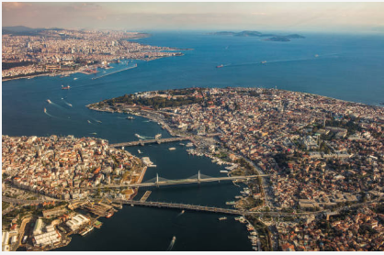
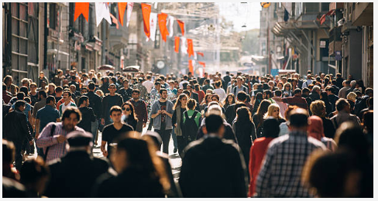
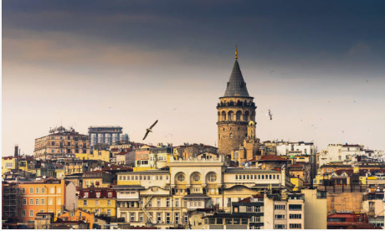
Highly attractive for venue business
Istanbul is the largest city in Turkey and one of the largest metropolises in the world.
Istanbul had an estimated population of over 15 million and has a population density of 2813 people per square kilometer.
13.4 million foreign tourists – 2018

Slide 3
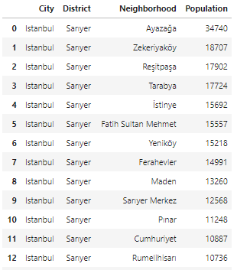
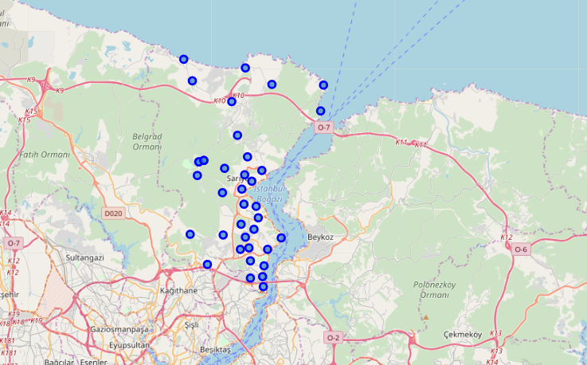
Data Acquisition&Cleaning
We will use http://www.nufusune.com/ web site to get the districts, neighborhoods and neighborhood population of Istanbul. For Sarıyer District, we get the dataframe below :
Neigbprhoods of Sarıyer district are plotted in a map with the help of Geocoder Package

Slide 4
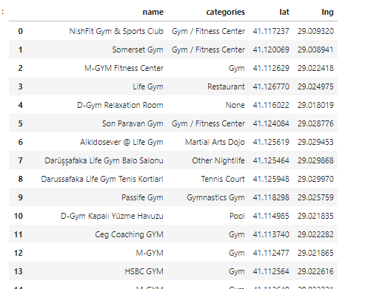
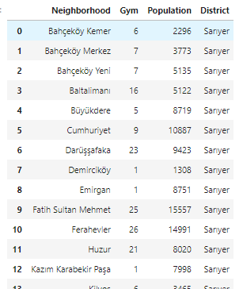
Foursquare API
List of gyms are gathered for each neigborhood.
Maslak Neighborhood - Sarıyer District
Number of gyms and population for each neighborhoods are added to dataframe .
Sarıyer District

Slide 5
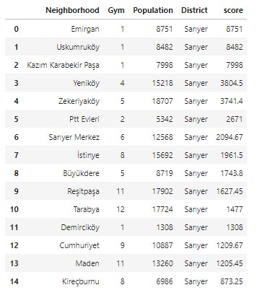
Result
For a given neigborhood :
Score = Population / Number of Gyms - simply gives us how many gyms exist for score.
Descending order based on score. Less score >> Better result. For example, we have only one gym in Emirgan which could be a very good candidate for a new gym.
We can conclude that first three neigborhoods (Emirgan, Uskumrukoy and Kazım Karabekir Paşa) with the highest scores are best location for a new gym.
We can implement this model for others districts and othet kinds of venues.

Slide 6
Conclusion and improvement directions
After picking the best neighborhood, there is a lot more work that needs to be done to actually find the best solution. However, this project gives a nice start.
We should also consider GDP per capita of each neighborhood.

